Slide 1


Slide 2

Introduction
Enhancing an existing control
  Creating a custom control using the Windows Control Library Project
Creating the DLL File
Using the custom control in a Windows Control Library Project
Modifying the custom control

Slide 3

Although VB.NET have a wide variety of controls, we may sometimes requires customized controls in our Windows Applications
There are three ways in which a custom control can be created:
  Designing a new control that inherits an existing control and adds some extra functionality.
  Designing a new control that combine multiple .NET controls. Such controls are called as compound controls.
  Designing a user-drawn control which is an empty surface where the control’s interface is needed to be drawn.

Slide 4

One of the approaches of creating custom controls is by enhancing existing controls i.e. we will be creating a new control which is a subclass of an existing control.
Thus, the new control inherits the visual interface and all the functionality of an existing control (or base class).
Then, we will add additional functionality which we require by means of properties or methods

Slide 5

We need to create a new Windows Control Library Project , it will open a new, blank UserControl control
In Solution Explorer, select the UserControl and display its code. It will look like this
Public Class UserControl1
End Class

Slide 6

Edit the Inherits statement so that the class inherits from an existing control rather than from the UserControl1. Something like:
Public Class MyTextBox
Inherits System.Windows.Forms.TextBox
End Class
Be sure to change the File Name of the new control from its properties window to an appropriate name. (Select the control from the Solution Explorer to get its properties)
Save the project

Slide 7

To make use of custom controls, we have to create DLL file of the project by compiling the class project.
Through a DLL file of the project, we can make use of the control in any other project that needs custom control.
The DLL file will be created in the \Obj\Release folder under the project’s folder.

Slide 8

To do this click on Build->Configuration Manager
This will open a Dialog Box, instead of Debug, select Release
Then, Build the project from Build Menu
Remove the error generated, by clicking on it and commenting that line of code
The DLL file will be stored in the projects folder

Slide 9

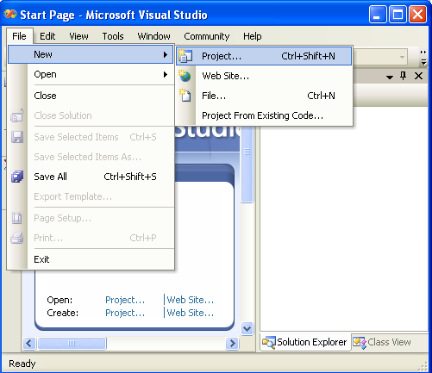

Slide 10

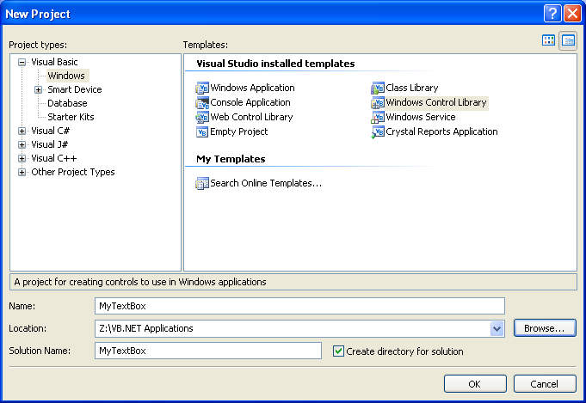

Slide 11

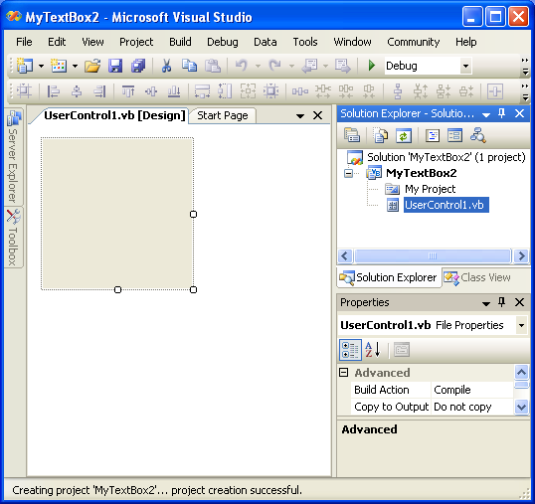

Slide 12

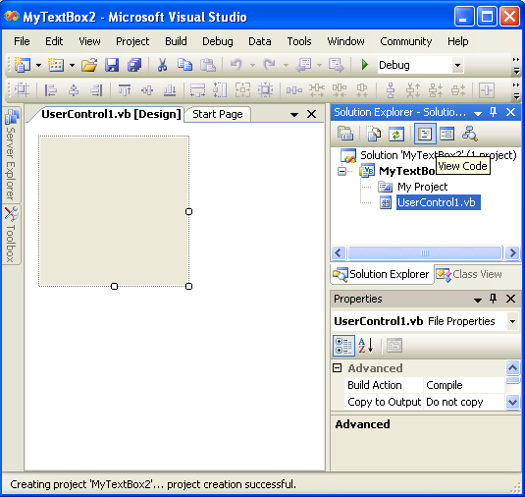
Click Here

Slide 13

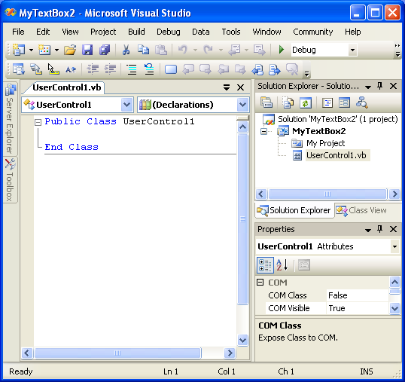

Slide 14

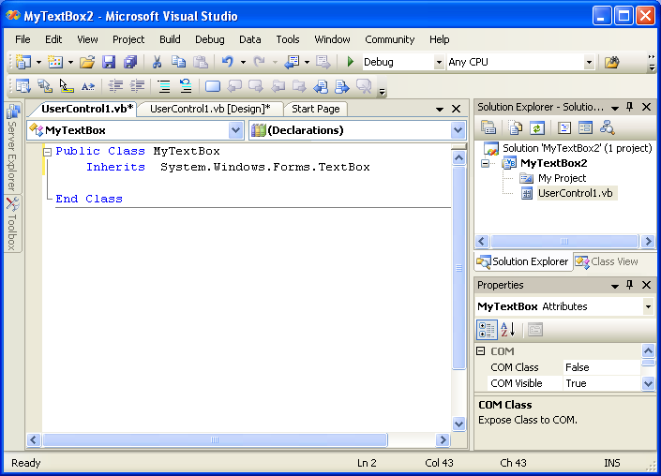

Slide 15

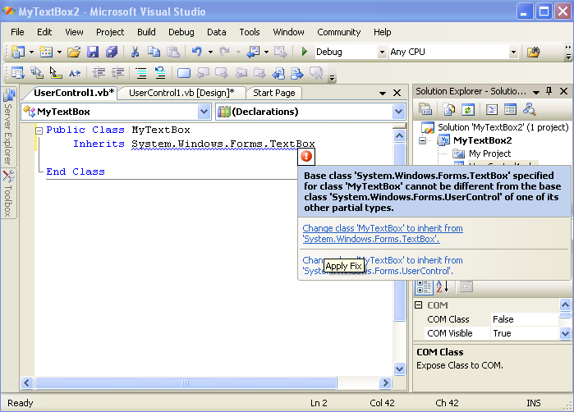
Select the first option

Slide 16

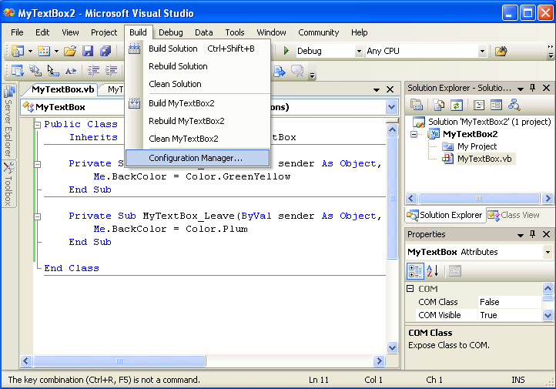

Slide 17

If you do not find Configuration Manager under Build Menu, then go to
  Tools -> Options
  It will open a dialog box,
    Select Projects and Solutions
    Check on show advanced build options

Slide 18

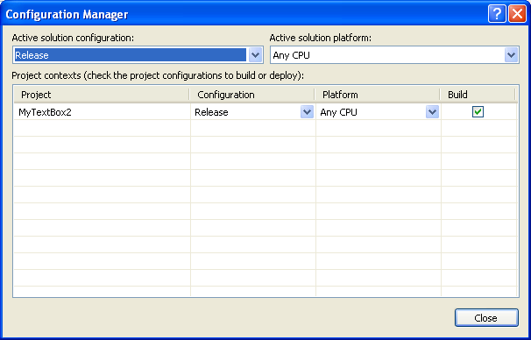

Slide 19

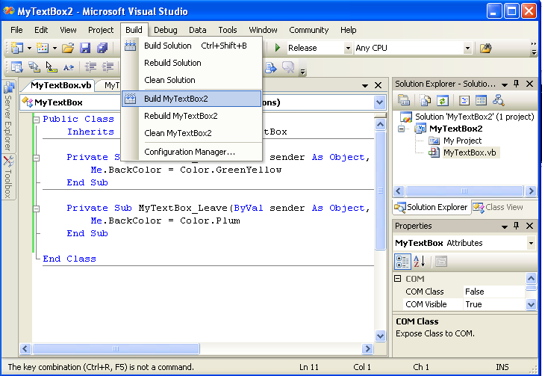

Slide 20

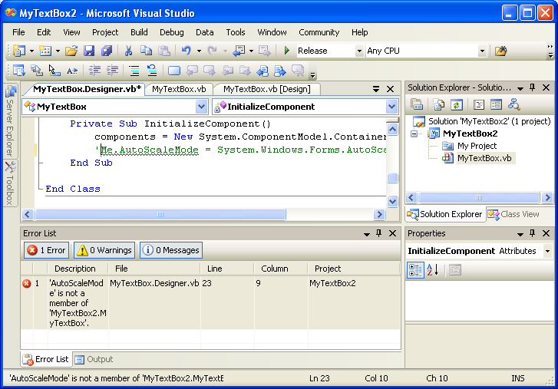

Slide 21

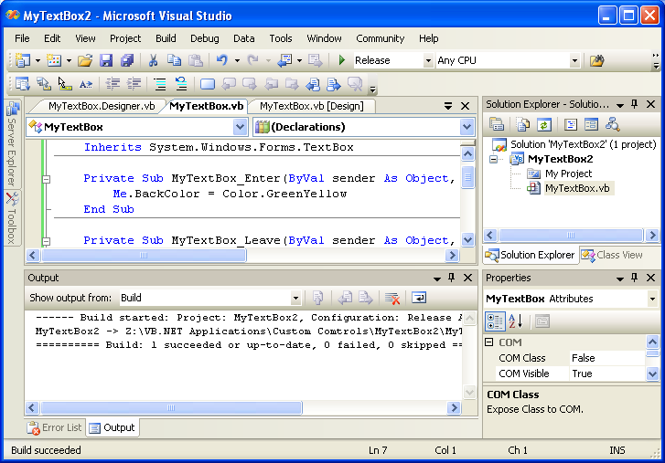

Slide 22

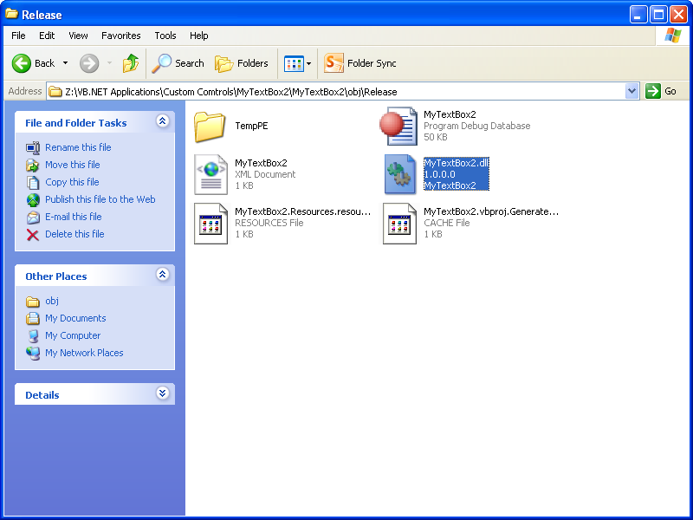

Slide 23

Public Class MyTextBox
Inherits TextBox
Private Sub MyTBox_Enter(ByVal sender As Object, ByVal e As System.EventArgs) Handles Me.Enter
Me.BackColor = Color.Orange
End Sub
Private Sub MyTBox_Leave(ByVal sender As Object, ByVal e As System.EventArgs) Handles Me.Leave
Me.BackColor = Color.LightSkyBlue
End Sub
End Class

Slide 24


Slide 25
We must remember to close the custom control application and then create a new Windows Application Project
Then we must add the DLL file of the custom control to this application. (Steps shown in the next slide)
The control name will appear in the toolbox of the application
Then we can drag & drop the control to the form as many times as we need

Slide 26
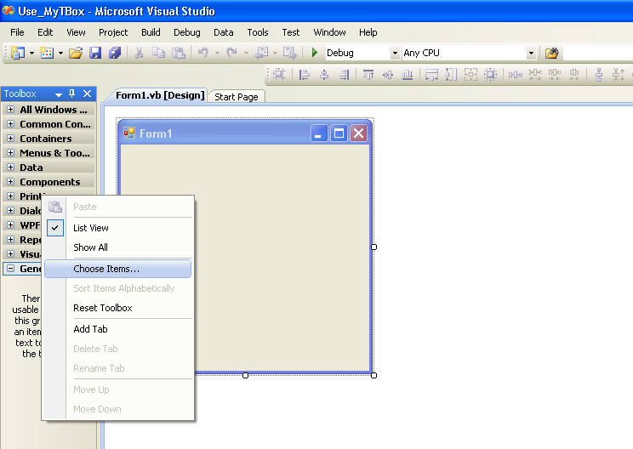

Slide 27

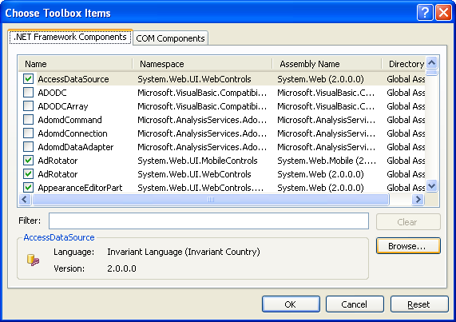

Slide 28

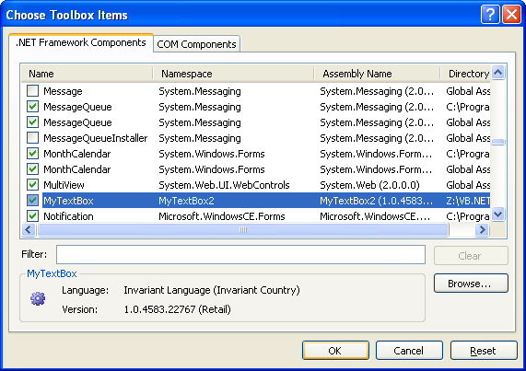

Slide 29

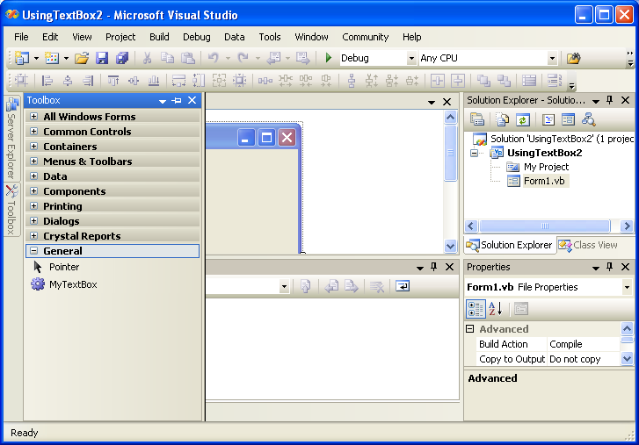

Slide 30
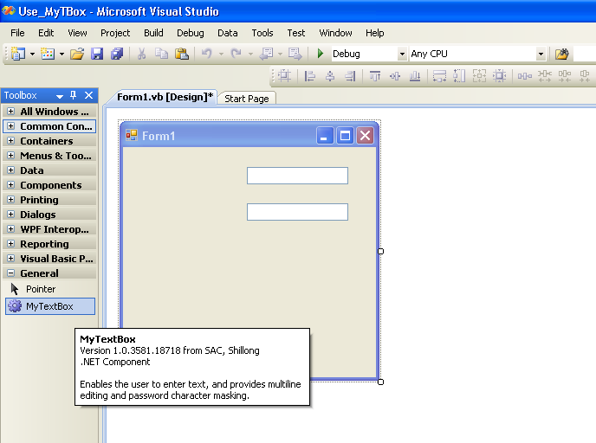

Slide 31
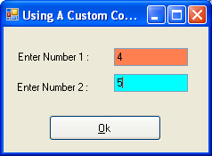
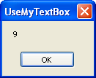
Using A
Custom Control
That Is Inherited
From A TextBox
Public Class Form1
Private Sub Button1_Click(… …) Handles Button1.Click
Dim n As Integer
n = MyTextBox1.Text + MyTextBox2.Text
MsgBox(n)
End Sub
End Class

Slide 32


Slide 33

If we want to make changes to an already create custom control, we must make sure that all applications making use of this control are closed
Then, we can open the Project of the Custom Control and make the necessary changes.
Rebuild the project (i.e. Compiling the project to create an updated DLL File)
Then, close the project and run the application using it, you will see the changes are updated in the custom control

Slide 34


Slide 35

A compound control provides a visible interface that combines multiple Windows controls.
For example, if we need to combine two or more text boxes along with their corresponding labels, and treat it as one control, it will be considered as a compound control.

Slide 36

Start with a new Windows Control Library project.
Place the appropriate controls required to use on the UserControl object to make it behave as a Custom Compound Control.
Change the name of the UserControl in the Properties Windows
Get the coding written for the UserControl object.
Once done, build the control to create a DLL file.
That’s all!
Now start with a new Windows Application Project. Choose the UserControl tool (the DLL file) from the toolbox by right-clicking on the ToolBox and choosing the option ‘Choose Items…’.
Add the tool in the form and carry out further steps to complete the program.

Slide 37

Any control forming the compound control must be treated as a property of the class
So to access any value from the controls, we must have a suitable property procedure.
For example:
  The compound control having two textboxes will have two property procedures to set & get their values

Slide 38

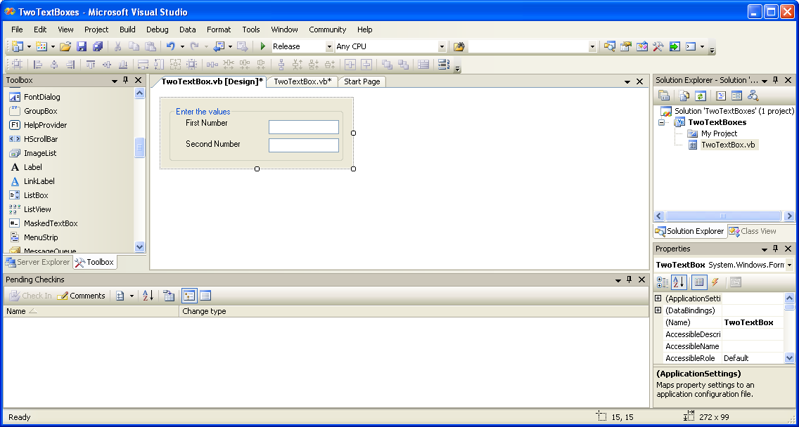

Slide 39

Public Class TwoTextBox
Property number1( ) As String
Get
number1 = txtNum1.Text
End Get
Set(ByVal value As String)
txtNum1.Text = value
End Set
End Property
Property number2( ) As String
Get
number2 = txtNum2.Text
End Get
Set(ByVal value As String)
txtNum2.Text = value
End Set
End Property
End Class

Slide 40

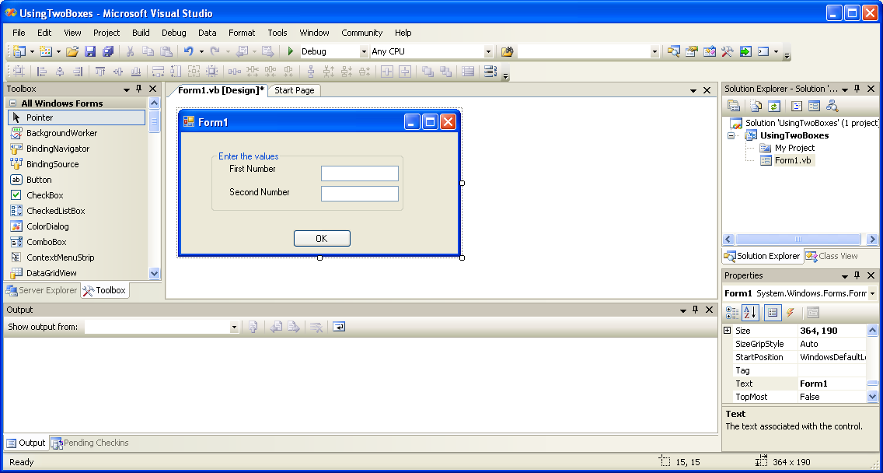

Slide 41

In the Windows Application, button click event
  Public Class Form1
  Private Sub Button1_Click(… …) Handles Button1.Click
  Dim n1, n2 As Single
  n1 = TwoTextBox1.number1
  n2 = TwoTextBox1.number2
  MsgBox(“SUM = “ & (n1+n2))
  End Sub
  End Class

